Slide 1
Project Presentation
Topic: Two City Comparison

Slide 2
Summary
Todays is the age of internet, the information is so easily available online that its quite convenient to extend your business in any other city around the world. It makes it easier if the targeted city is geographically not far away and it is easy for the owners to travel between the cities. Only thing left is to explore both places and do a quick comparison between the two cities to find out the best places in the city to target at.
I have tried to do the best co-relation between two cities to get the final recommendation

Slide 3
Data Set Used:
Foursquare location data – I will be collecting information around the place such as hotels, Coffee shops, parks, Cinemas, offices, Museums, Restaurants etc.
Lab work done for Toronto & New York City – Will us clustering to segment the neighborhood with similar objects based on each neighborhood data. This will help to locate the relevant areas and hubs, and then we can judge the similarity or dissimilarity between two cities.

Slide 4
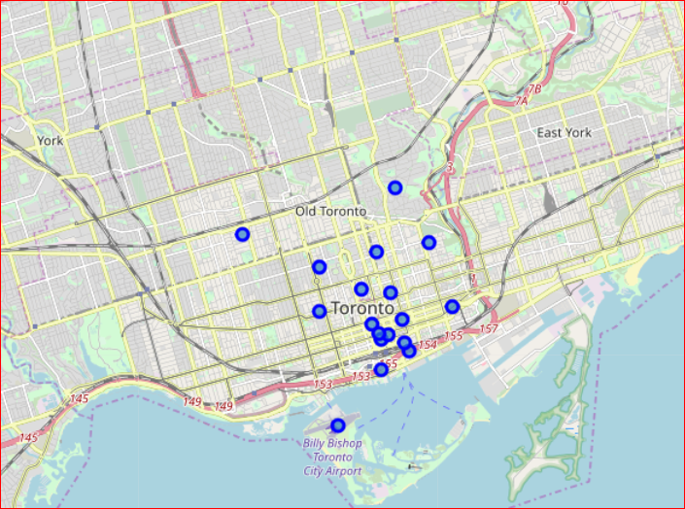
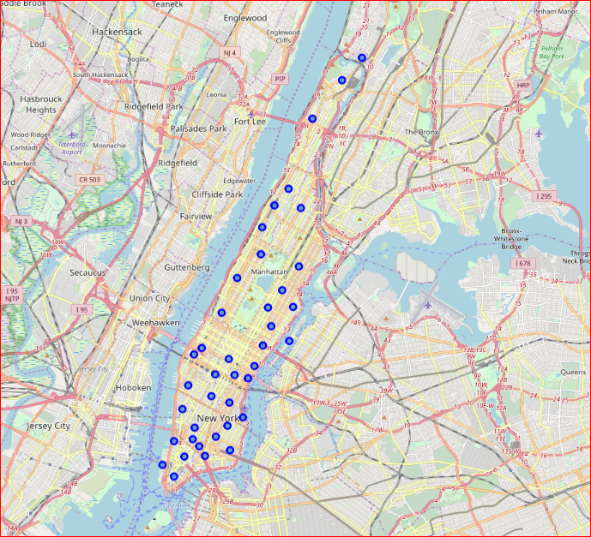
Area Chosen:
Downtown Toronto
Manhattan

Slide 5
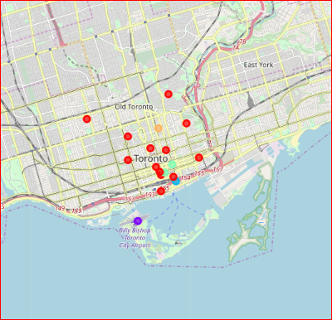
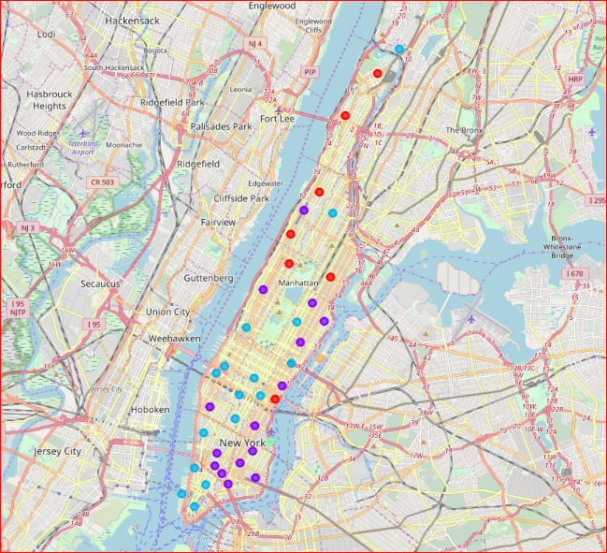
Clustering was performed on both cities data set
Downtown Toronto
Manhattan

Slide 6
Result & Conclusion
Results:
After clustering the data of the both Downtown Toronto & Manhattan neighborhoods, both cities have similarities in terms of high number of residential area and common places like cinemas, food places. As far as concern to dissimilarity, downtown Toronto has less numbers of parks
Observations & Recommendations:
Airport facility, Harbor, Sculpture garden and Boat or ferry services are also available in Downtown Toronto while venues like Nightlife, Climbing gym and Museums are present in Manhattan. From business point of view, recommendation is to have restaurant kind of business in downtown Toronto
Conclusion:
The downtown Toronto and Manhattan neighborhoods have more like similar venues. As we know that every place is unique in its own way, so that is argument is present in both neighborhoods. The dissimilarity exists in terms of some different venues and facilities but not on a larger extent

